Slide 1

ANTON GRDINA ELEMENTARY SCHOOL
REDESIGN

Slide 2
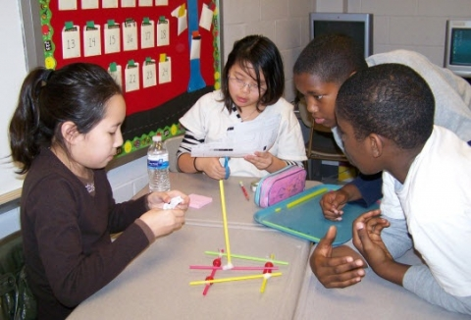
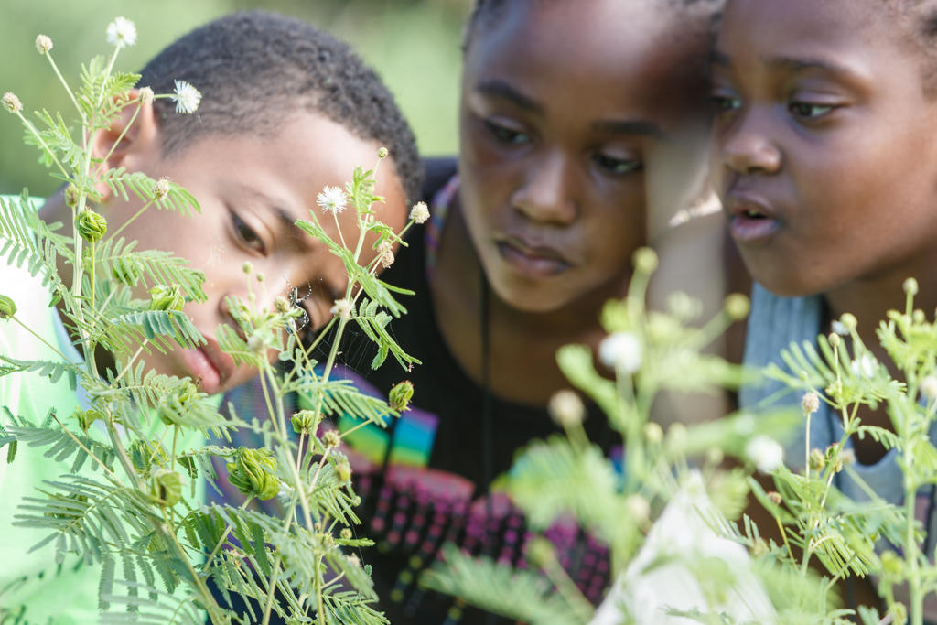
Inquiry Based Learning at Anton Grdina
Year 1-2018/2019
Beginning in Science
Year round study of plants
SCHOLARS WILL: Design experiments, conduct research, discuss findings
Make connections with other subject areas: Math, ELA

Slide 3

INQUIRY IS…Learning by questioning and investigation

Slide 4
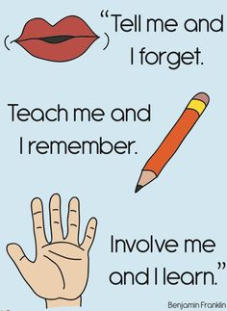

Slide 5
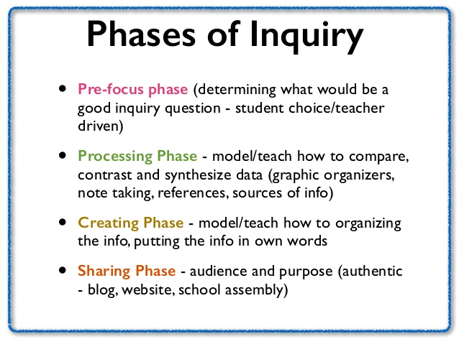
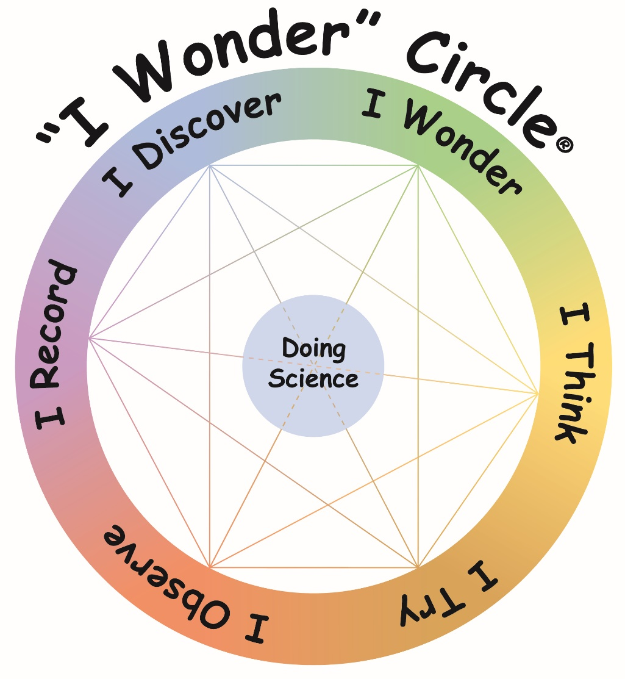
I WONDER…

Slide 6
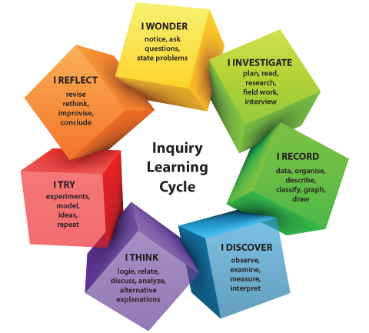

Slide 7
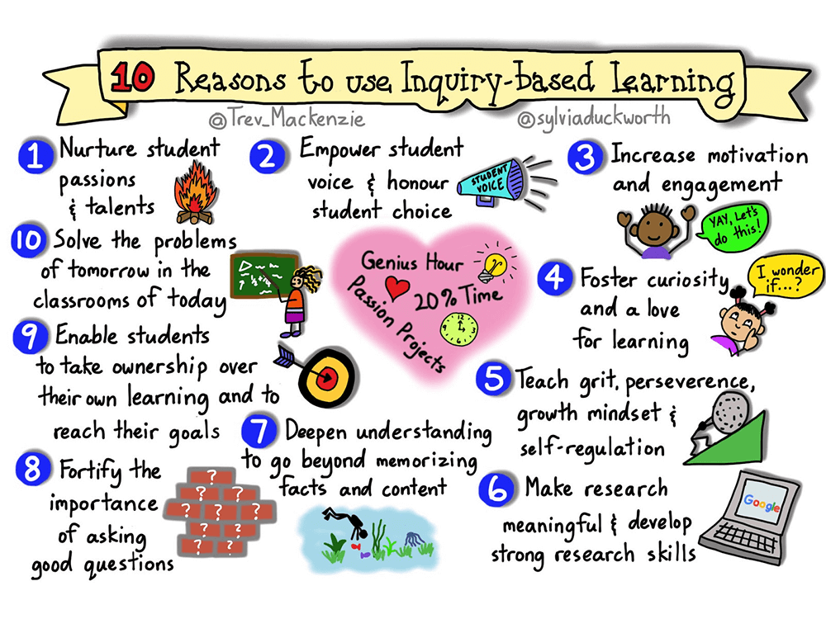

Slide 8

IBL at ANTON GRDINA:
EMPOWERS STUDENT VOICES
INCREASES MOTIVATION AND ENJOYMENT
FOSTERS CURIOSITY AND A LOVE OF LEARNING
ALLOWS SCHOLARS TO TAKE OWNERSHIP OF THEIR LEARNING TO REACH THEIR GOALS

Slide 9
AT ANTON GRDINA,
We Inspire
We Discover
We innovate
To achieve academic success
Preparing scholars today to solve the problems of tomorrow

